Slide 1
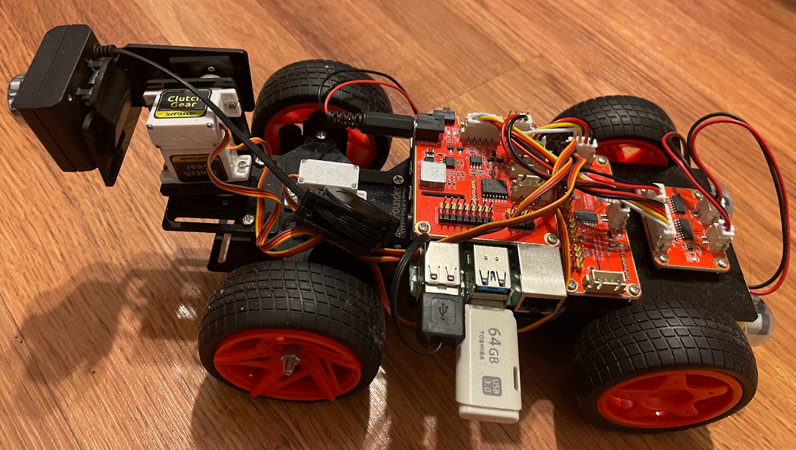
Automatic lane navigation of a robotic car using deep learning models
Lakshmikar R Polamreddy
Harsha Koduri
Jatin Kayasth
AI Final project
Dec 18, 2023

Slide 2
Agenda
Introduction
Relevant literature
Approach
Responsibilities
Project set up
Data collection
Model training
Results
Challenges
Conclusions
Future work
Codes and GitHub link
References

Slide 3
Introduction
The focus of this project is to build a physically build a robotic car for autonomous lane navigation using deep learning models
Gather our own training data using the robotic car
Test the performance of the state-of-the-art NVIDIA model
Build our own CNN model and compare its performance with that of NVIDIA model

Slide 4
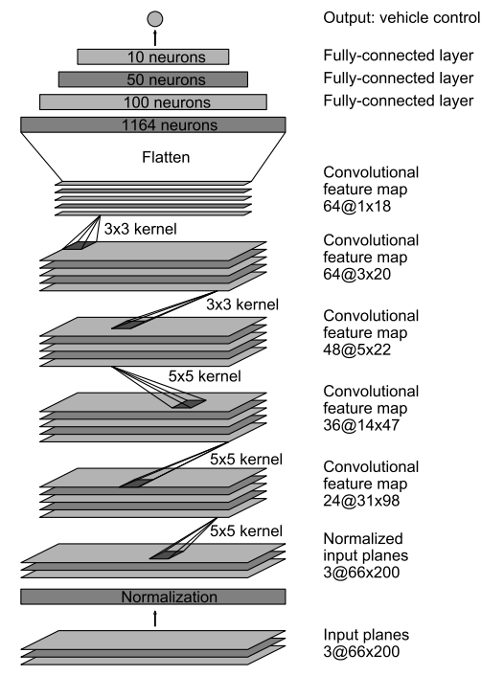
Relevant Literature
Bojarski et al. Bojarski et al. [1], as part of the NVIDIA research team, proposed a new convolutional neural network (CNN) architecture for end-to-end deep learning for self-driving cars.
David Tian[2] proposed how to build our own physical, deep-learning, self-driving robotic car from scratch and to make our car detect and follow lanes.
NVIDIA model architecture [1]

Slide 5
Approach
Construct car
Construct a physical robotic car
Prepare a track on the wooden floor
Drive the car autonomously using OpenCV and gather training data – images and steering angles
Train the deep learning model with this training data
Output from the model is the predicted steering angle
Calculate regression loss between the actual and the predicted steering angles.
Once the loss converges, save and use the model weight to test the performance in terms of R-squared value and compare the lane follower videos of deep learning and openCV
Prepare track
Gather training data
Train the deep learning model
Predict steering angles
Save the model weight
Test the model performance

Slide 6
Responsibilities
Lakshmikar P | Project proposal and project management Purchase of hardware components Physical construction of the robotic car Physical lane preparation Installation of necessary softwares and libraries Data collection for training Code for steering angle calculation Custom model architecture Training the NVIDIA model with smaller datasets (video-1 and videos-1,2) Training our CNN model with smaller datasets (video-1 and videos-1,2) Preparation of the report and presentation
Harsha K | Physical construction of the robotic car Physical lane preparation Installation of necessary softwares and libraries Codes for data collection using OpenCV Data collection for training Training the NVIDIA model with larger dataset (videos-1,2,3) Comparison of the results of deep learning models with OpenCV Preparation of the report
Jatin K | Physical lane preparation Installation of necessary libraries Data collection for training Training our CNN model with larger dataset (videos-1,2,3) Preparation of the report

Slide 7
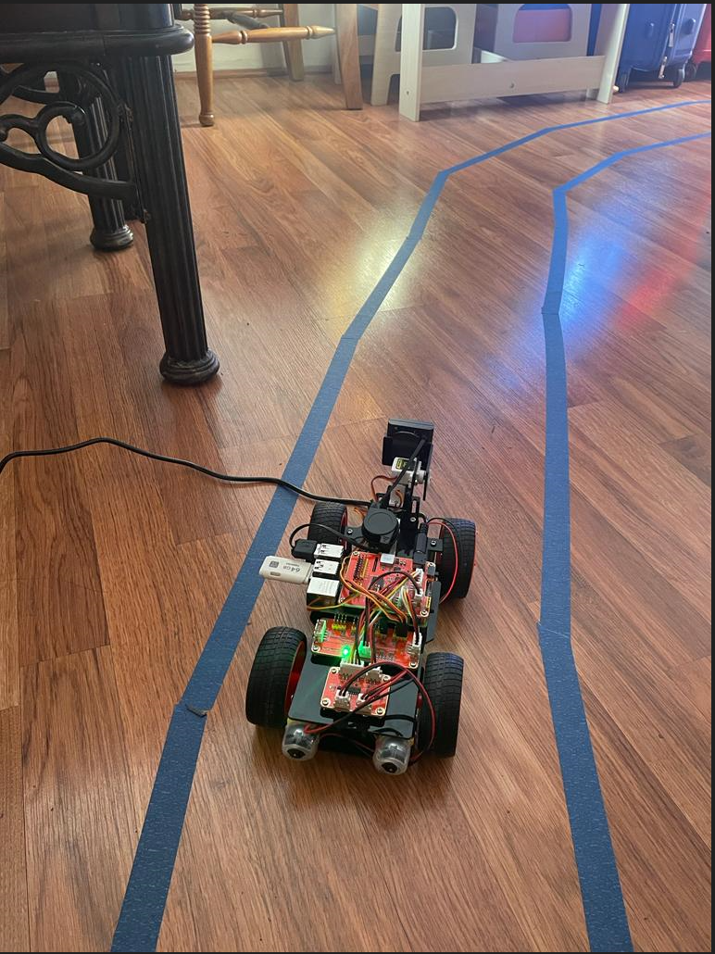
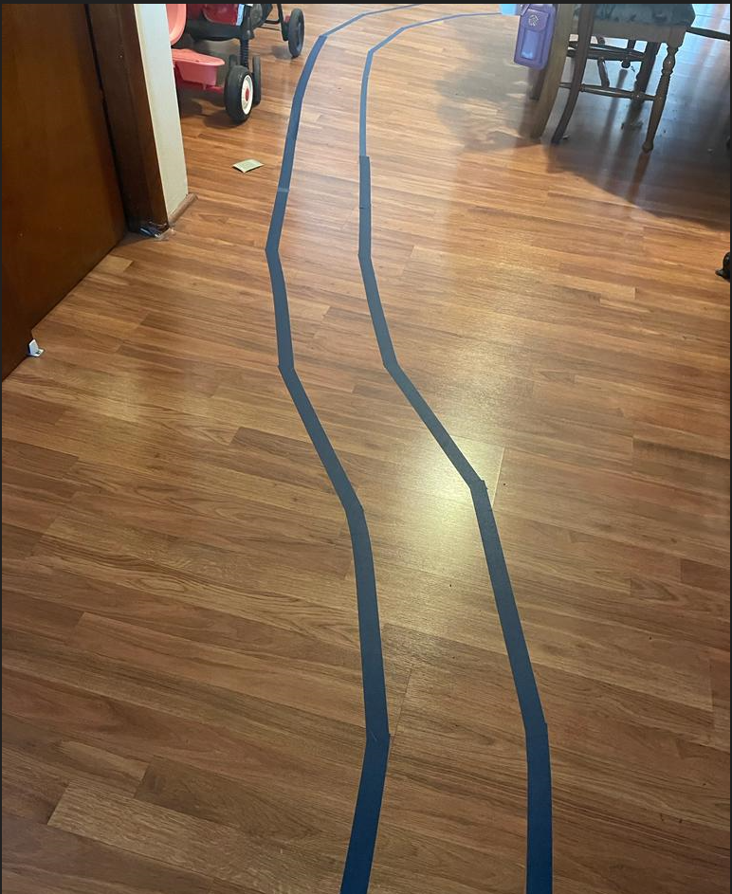
Project set up
Hardware components -
Raspberry Pi 4 computer – to load the software and libraries
USB Drive
SunFounder PiCar-V kit with camera module– main body of the robotic car
Camera module - 120 degree wide-angle camera with resolution 640x320 pixels
Few other accessories
Lane preparation with blue tape on the wooden floor
Software components -
Operating system: Raspberry Pi OS
PuTTY, VNC Server/client
Python virtual environment setup – Python 3.9, OpenCV, Tensorflow
Camera module - to run deep learning models written in TensorFlow
Few other accessories
Lane preparation with blue tape on the wooden floor
Testing the software and hardware components -
Validate working of the front and the rear wheels by controlling them through the pi terminal
Make sure that OpenCV is also working by visualizing the black and color images of the lane on our laptop.
Images of the robotic car and the lane

Slide 8
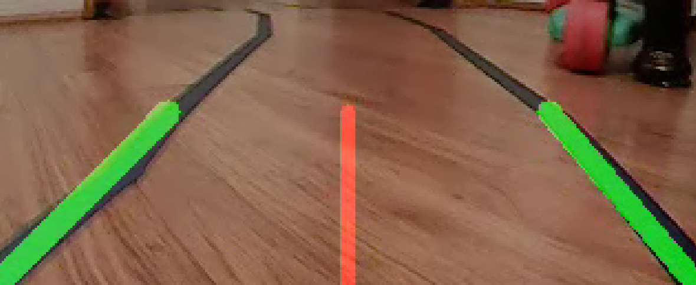
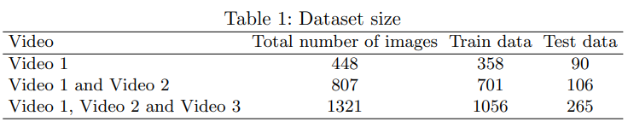
Data collection
On the prepared lane, robotic car is driven using OpenCV that detects the edges of the tracks
Steering angle is calculated based on the following:
Consider the first and last elements of the list of the detected lanes (Green lanes)
Compute the average of these 2 elements and join these elements as shown like the red line segment
Then calculate the slope of this red line with respect to the frame width.
Created 3 videos as part of data collection for training as shown below in Table. 1
Images with respective steering angles are created from these videos
Another test video is created and used for comparing the results of lane navigation of deep learning models with that of OpenCV
Track detection

Slide 9
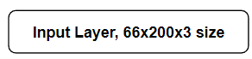
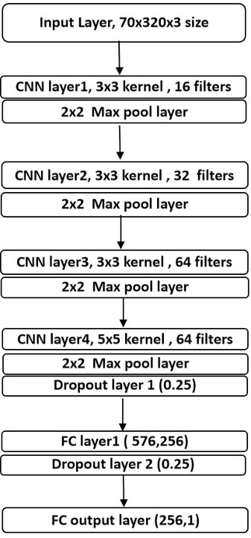
Our CNN model architecture
4 Convolutional layers
2 fully connected layers
Total trainable parameters : 208,481 (NVIDIA parameters - 252,219)
Our CNN model architecture

Slide 10
Model training
Images and respective steering angles collected from the robotic car camera are passed onto the model
Model training is done using the hyper parameters as shown below.
Number of epochs: 20
Number of steps per epoch: 300 ​
Batch size: 100
Optimizer: Adam ​
Learning rate: 0.001
Data Augmentation is done by using techniques like zoom, pan, adjusting brightness, crop, random flip, and blur
Model outputs the predicted steering angle for test images
Performance metrics: Regression loss in terms of MSE, R-squared value
Trained both the models (NVIDIA and Our CNN model) for each of the three datasets

Slide 11
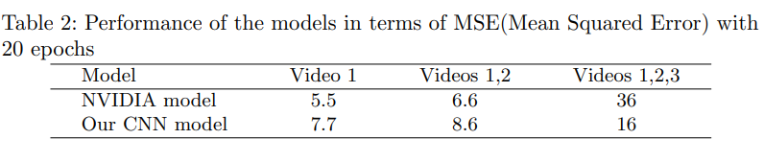
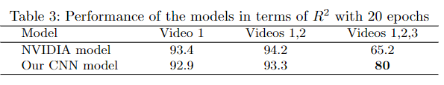
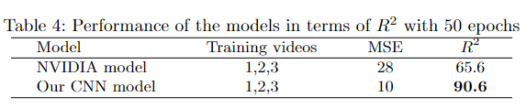
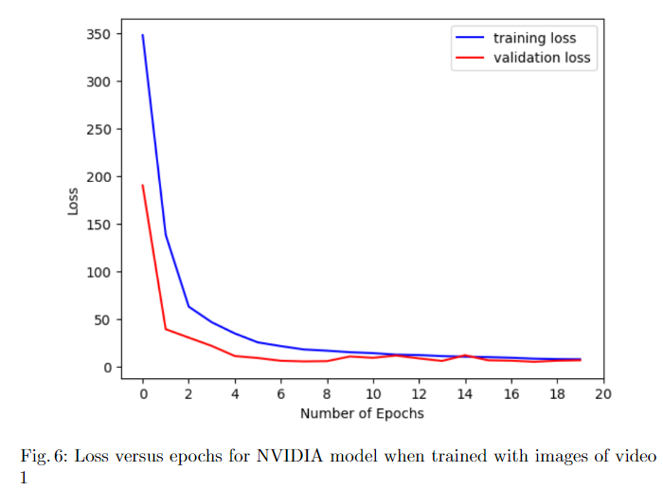
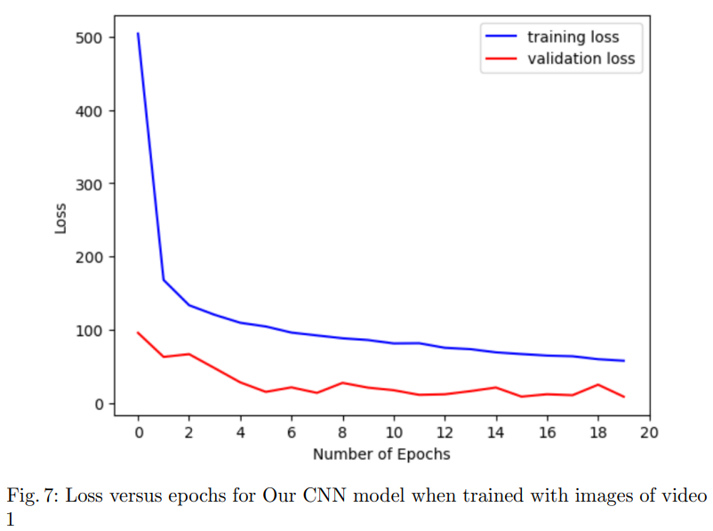
Results
Our results are consolidated and shown in the Table. 2 and Table. 3
We obtain these results after training the models for 20 epochs and then testing with 20 percent of the data from the images extracted from videos 1, 2, and 3
We notice that both the models have shown similar performance in terms of R-squared when trained with the images of videos 1 and 2
Our CNN model outperforms NVIDIA model when combined with images of all the three videos
However, both the models show relatively poor results in the latter case. It is due to the reason that the loss did not converge in 20 epochs and so, we further train the model for 50 epochs and these results are shown in the Table.Table. 4
In this case, Our CNN model shows better performance than that of NVIDIA model
Result video using weights, showing the comparison of deep learning video and openCV video

Slide 12
Challenges
Setting up the front wheels
Installation of OpenCV and Tensorflow on Raspberry pi
Driving the car autonomously using OpenCV
Failure of SD card
Steering angle calculation
Limited training data.

Slide 13
Conclusions
Our CNN model with fewer parameters demonstrated similar performance to that of the NVIDIA in terms of R squared value for smaller datasets
In case of larger datasets, our CNN model outperformed NVIDIA model

Slide 14
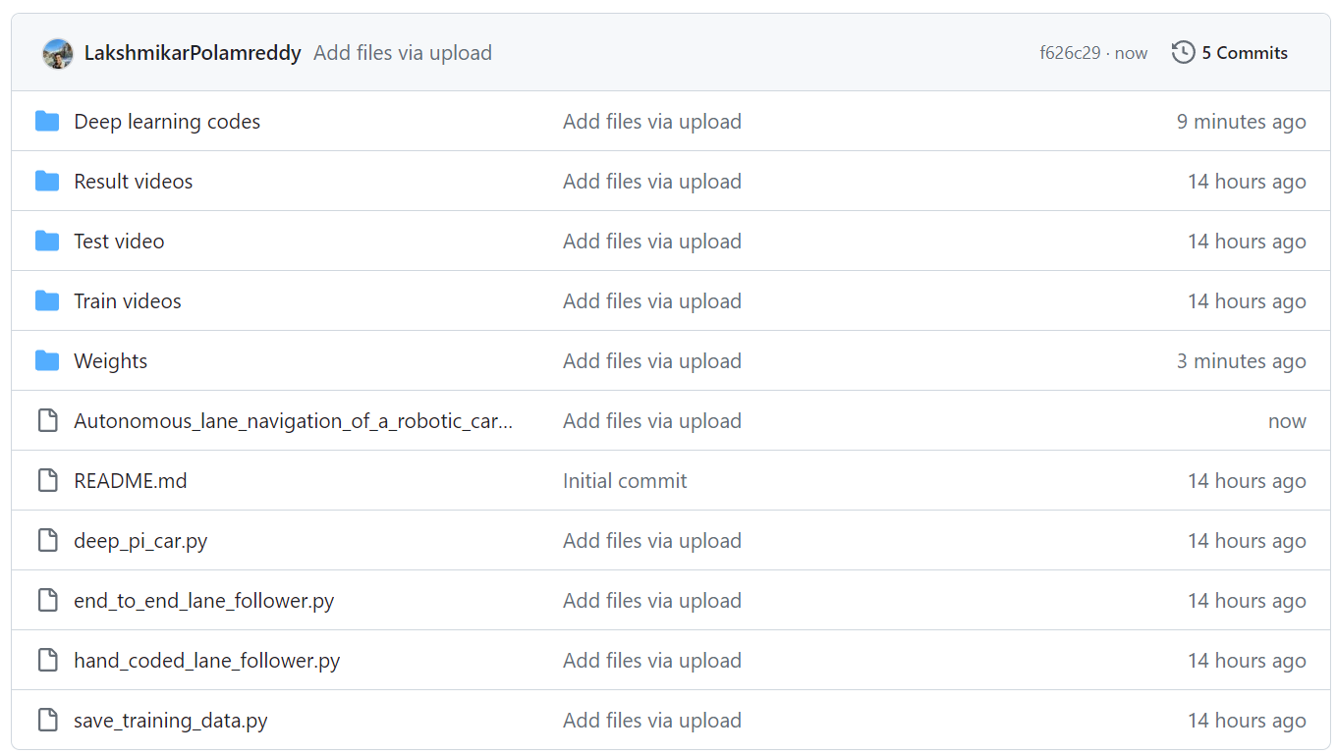
Codes and GitHub link
Follow this link for dataset, codes, results and report
https://github.com/LakshmikarPolamreddy/Autonomous_lane_navigation_robotic_car_deep_learning_models
Deep learning codes - contains 8 codes of NVIDIA and our CNN model training
deep_pi_car.py - To drive the sun-founder car
hand_coded_lane_follower.py - For steering angle calculation
save_training_data.py - To create frames from the videos
end_to_end_lane_follower.py - To compare the performance of the deep learning model with OpenCV videos by loading the model weight.
Reference for the above 4 codes is listed in Ref[3]

Slide 15
Future work
Test the performance of these models by deploying them on the physical robotic car
Test the performance of these models by generating more training data on multiple tracks
Extend this work beyond lane navigation to perform traffic sign and pedestrian detection and handling during navigation

Slide 16
References
Bojarski, M., Del Testa, D., Dworakowski, D., Firner, B., Flepp, B., Goyal, P., ... & Zieba, K. (2016). End to end learning for self-driving cars. arXiv preprint arXiv:1604.07316.
https://towardsdatascience.com/deeppicar-part-1-102e03c83f2c
https://github.com/dctian/DeepPiCar

Slide 17
Questions?

Slide 18
Thank you!

